Slide 1
Lesson 18
Creating Compound, DDL,
and Event Database Triggers

Slide 2
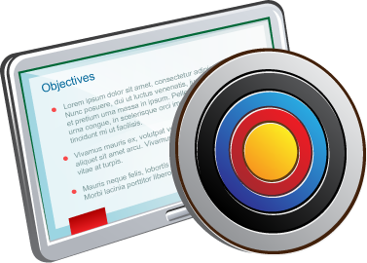
Objectives
After completing this lesson, you should be able to:
  Describe compound triggers
  Describe mutating tables
  Create triggers on DDL statements
  Create triggers on system events
  Display information about triggers

Slide 3

Lesson Agenda
  Create compound DML triggers
  Resolve mutating table errors
  Schema triggers
  Database triggers
  Guidelines for designing triggers

Slide 4
What is a Compound Trigger?
  A single trigger on a table that allows you to specify actions for each of the following four timing points:
    BEFORE
    BEFORE EACH ROW
    AFTER EACH ROW
    AFTER
  Each timing instance has an executable part and an optional exception handling section.
  All the timing instances access a common PL/SQL state.

Slide 5
Working with Compound Triggers
  The compound trigger body supports a common PL/SQL state that the code for each timing point can access.
  The compound trigger common state is:
    Established when the triggering statement starts
    Destroyed when the triggering statement completes
  A compound trigger has a declaration section and a section for each of its timing points.
  The section of each timing point may have an optional exception handling section

Slide 6
Why Compound Triggers?
You can use compound triggers to:
  Program an approach where you want the actions you implement for the various timing points to share common data
  Accumulate rows destined for a second table so that you can periodically bulk-insert them
  Avoid the mutating-table error (ORA-04091)

Slide 7

Compound Trigger Structure
CREATE OR REPLACE TRIGGER schema.trigger
FOR dml_event_clause ON schema.table
COMPOUND TRIGGER
[ declare_section ]
timing_point_section [ timing_point_section ]... END [ trigger ] ;

Slide 8

Compound Trigger Structure for Views
CREATE trigger FOR dml_event_clause ON view
COMPOUND TRIGGER
INSTEAD OF EACH ROW IS
BEGIN
statement;
END INSTEAD OF EACH ROW;

Slide 9
Compound Trigger Restrictions
  A compound trigger must be a DML trigger defined on either a table or a view.
  An exception that occurs in one section must be handled in that section. It cannot transfer control to another section.
  A timing-point section cannot handle exceptions raised in another timing-point section.
  :OLD and :NEW cannot appear in the declaration, BEFORE STATEMENT, or the AFTER STATEMENT sections.
  Only the BEFORE EACH ROW section can change the value of :NEW.

Slide 10
Lesson Agenda
  Create compound DML triggers
  Resolve mutating table errors
  Schema triggers
  Database triggers
  Guidelines for designing triggers

Slide 11
Mutating Tables
  A mutating table is:
    A table that is being modified by an UPDATE, DELETE, or INSERT statement
    or
    A table that might be updated by the effects of a DELETE CASCADE constraint
  The session that issued the triggering statement cannot query or modify a mutating table.
  This restriction prevents a trigger from seeing inconsistent data.
  This restriction applies to all triggers that use the FOR EACH ROW clause.
  Views being modified in the INSTEAD OF triggers are not considered mutating.

Slide 12

Mutating Table: Example
CREATE OR REPLACE TRIGGER check_salary
BEFORE INSERT OR UPDATE OF salary, job_id
ON employees
FOR EACH ROW
WHEN (NEW.job_id <> 'AD_PRES')
DECLARE
v_minsalary employees.salary%TYPE;
v_maxsalary employees.salary%TYPE;
BEGIN
SELECT MIN(salary), MAX(salary)
INTO v_minsalary, v_maxsalary
FROM employees
WHERE job_id = :NEW.job_id;
IF :NEW.salary < v_minsalary OR :NEW.salary > v_maxsalary THEN
RAISE_APPLICATION_ERROR(-20505,'Out of range');
END IF;
END;
/

Slide 13

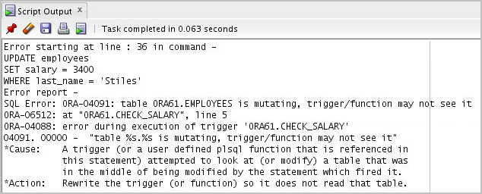
Mutating Table: Example
UPDATE employees
SET salary = 3400
WHERE last_name = 'Stiles';

Slide 14

Using a Compound Trigger to Resolve the Mutating Table Error
CREATE OR REPLACE TRIGGER check_salary
FOR INSERT OR UPDATE OF salary, job_id
ON employees
WHEN (NEW.job_id <> 'AD_PRES')
COMPOUND TRIGGER
TYPE salaries_t IS TABLE OF employees.salary%TYPE;
min_salaries salaries_t;
max_salaries salaries_t;
TYPE department_ids_t IS TABLE OF employees.department_id%TYPE;
department_ids department_ids_t;
TYPE department_salaries_t IS TABLE OF employees.salary%TYPE
INDEX BY VARCHAR2(80);
department_min_salaries department_salaries_t;
department_max_salaries department_salaries_t;
-- example continues on next slide

Slide 15

Using a Compound Trigger to Resolve the Mutating Table Error
. . .
BEFORE STATEMENT IS
BEGIN
SELECT MIN(salary), MAX(salary), NVL(department_id, -1)
BULK COLLECT INTO min_Salaries, max_salaries, department_ids
FROM employees
GROUP BY department_id;
FOR j IN 1..department_ids.COUNT() LOOP
department_min_salaries(department_ids(j)) := min_salaries(j);
department_max_salaries(department_ids(j)) := max_salaries(j);
END LOOP;
END BEFORE STATEMENT;
AFTER EACH ROW IS
BEGIN
IF :NEW.salary < department_min_salaries(:NEW.department_id)
OR :NEW.salary > department_max_salaries(:NEW.department_id) THEN
RAISE_APPLICATION_ERROR(-20505,'New Salary is out of acceptable
range');
END IF;
END AFTER EACH ROW;
END check_salary;

Slide 16
Lesson Agenda
  Create compound DML triggers
  Resolve mutating table errors
  Schema triggers
  Database triggers
  Guidelines for designing triggers

Slide 17

Creating Triggers on DDL Statements
CREATE [OR REPLACE] TRIGGER trigger_name
BEFORE | AFTER -- Timing
[ddl_event1 [OR ddl_event2 OR ...]]
ON {DATABASE | SCHEMA}
trigger_body
Sample DDL Events | Fires When
CREATE | Any database object is created using the CREATE command.
ALTER | Any database object is altered using the ALTER command.
DROP | Any database object is dropped using the DROP command.

Slide 18

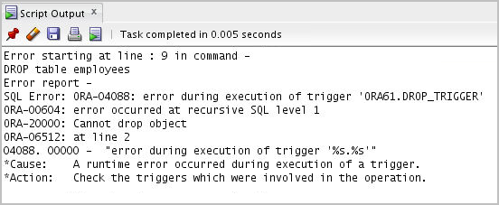
Creating Triggers on DDL Statements -Example
  CREATE OR REPLACE TRIGGER drop_trigger
  BEFORE DROP ON ora61.SCHEMA
  BEGIN
  RAISE_APPLICATION_ERROR ( num => -20000, msg => 'Cannot drop object');
  END;
  /
To check the execution of this trigger
  DROP TABLE employees;

Slide 19
Lesson Agenda
  Create compound DML triggers
  Resolve mutating table errors
  Schema triggers
  Database triggers
  Guidelines for designing triggers

Slide 20
Creating Database Triggers
  Triggering user event:
    Logging on or off
  Triggering a database event:
    Shutting down or starting up the database
    A specific error (or any error) being raised

Slide 21

Creating Triggers on System Events
CREATE [OR REPLACE] TRIGGER trigger_name
BEFORE | AFTER -- timing
[database_event1 [OR database_event2 OR ...]]
ON {DATABASE | SCHEMA}
trigger_body
2
Database Event | Triggers Fires When
AFTER SERVERERROR | An Oracle error is raised
AFTER LOGON | A user logs on to the database
BEFORE LOGOFF | A user logs off the database
AFTER STARTUP | The database is opened
BEFORE SHUTDOWN | The database is shut down normally
Value
Unique key column
Unique key column
Unique key column
Unique key column

Slide 22


LOGON and LOGOFF Triggers: Example
-- Create the log_trig_table shown in the notes page
-- first
CREATE OR REPLACE TRIGGER logon_trig
AFTER LOGON ON SCHEMA
BEGIN
INSERT INTO log_trig_table(user_id,log_date,action)
VALUES (USER, SYSDATE, 'Logging on');
END;
/
CREATE OR REPLACE TRIGGER logoff_trig
BEFORE LOGOFF ON SCHEMA
BEGIN
INSERT INTO log_trig_table(user_id,log_date,action)
VALUES (USER, SYSDATE, 'Logging off');
END;
/

Slide 23
Lesson Agenda
  Create compound DML triggers
  Resolve mutating table errors
  Schema triggers
  Database triggers
  Guidelines for designing triggers

Slide 24
Guidelines for Designing Triggers
  You can design triggers to:
    ensure that whenever a specific event occurs, any necessary actions are done.
  Don’t create triggers:
    which duplicate the function of the database
    which are recursive
  You can create stored procedures and invoke them in a trigger, if the PL/SQL code is very lengthy.

Slide 25

Quiz
Which of the following statements are true for a trigger?
  A trigger is defined with a CREATE TRIGGER statement.
  A trigger's source code is contained in the USER_TRIGGERS data dictionary.
  A trigger is explicitly invoked.
  A trigger is implicitly invoked by DML.
  COMMIT, SAVEPOINT, and ROLLBACK are not allowed when working with a trigger.

Slide 26
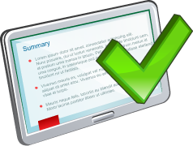
Summary
In this lesson, you should have learned how to:
  Describe compound triggers
  Describe mutating tables
  Create triggers on DDL statements
  Create triggers on system events
  Display information about triggers

